Slide 1
EXPLORING GLOBAL INEQUALITY AND GROWTH
PREPARED BY:
Kunal Gohrani
Bhavna Kumari
Sharika Anjum Mondal

Slide 2

At First, What is Global Inequality?
International Inequality refers to the idea of inequality between countries. This can be compared to global inequality which is inequality between people across countries.This may refer to economic differences between countries.

Slide 3
Investigating global inequality based on GNI per capita and wealth distributions over time
We are performing the data analysis among all the countries from 1962 to 2014 .
Our analysis’s aim is to find out the countries which are:
- POOR
- CONSISTENTLY POOR(THE COUNTRIES WHICH WERE POOR BOTH IN 1962 AND 2014)
- RICH
- CONSISTENTLY RICH(THE COUNTRIES WHICH WERE POOR BOTH IN 1962 AND 2014)
-COMPARING TOP POPULATED COUNTRIES ACCORDING TO ITS PER CAPITA INCOME.

Slide 4
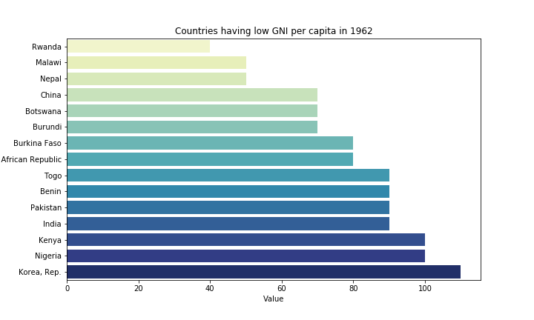
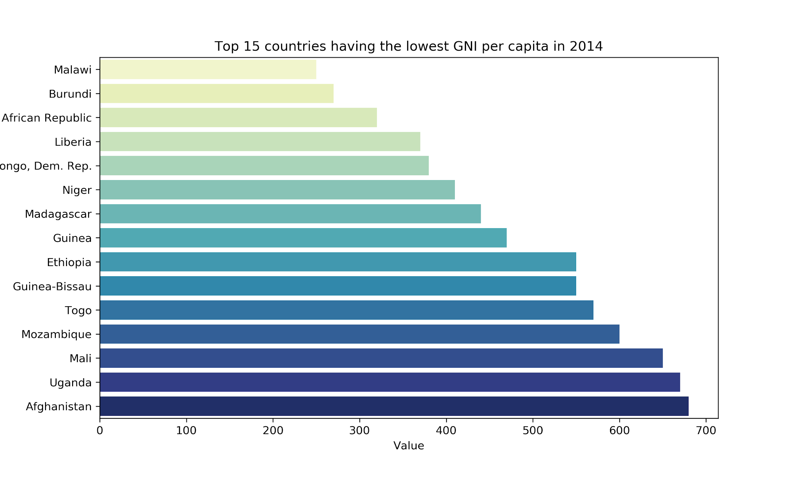
The first 15 poor countries on the basis of GNI per capita from 1962 and 2014

Slide 5
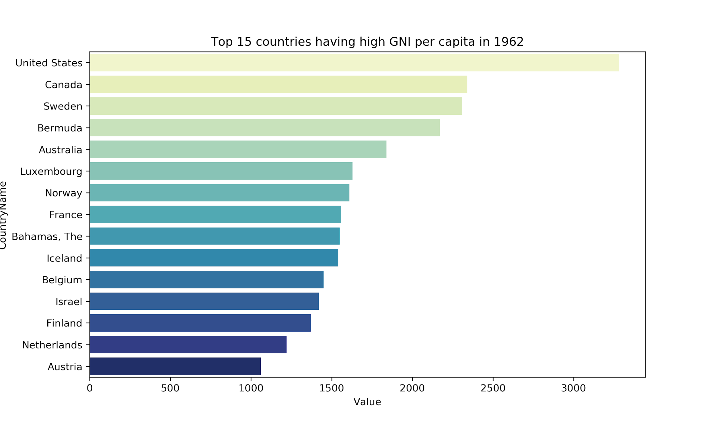
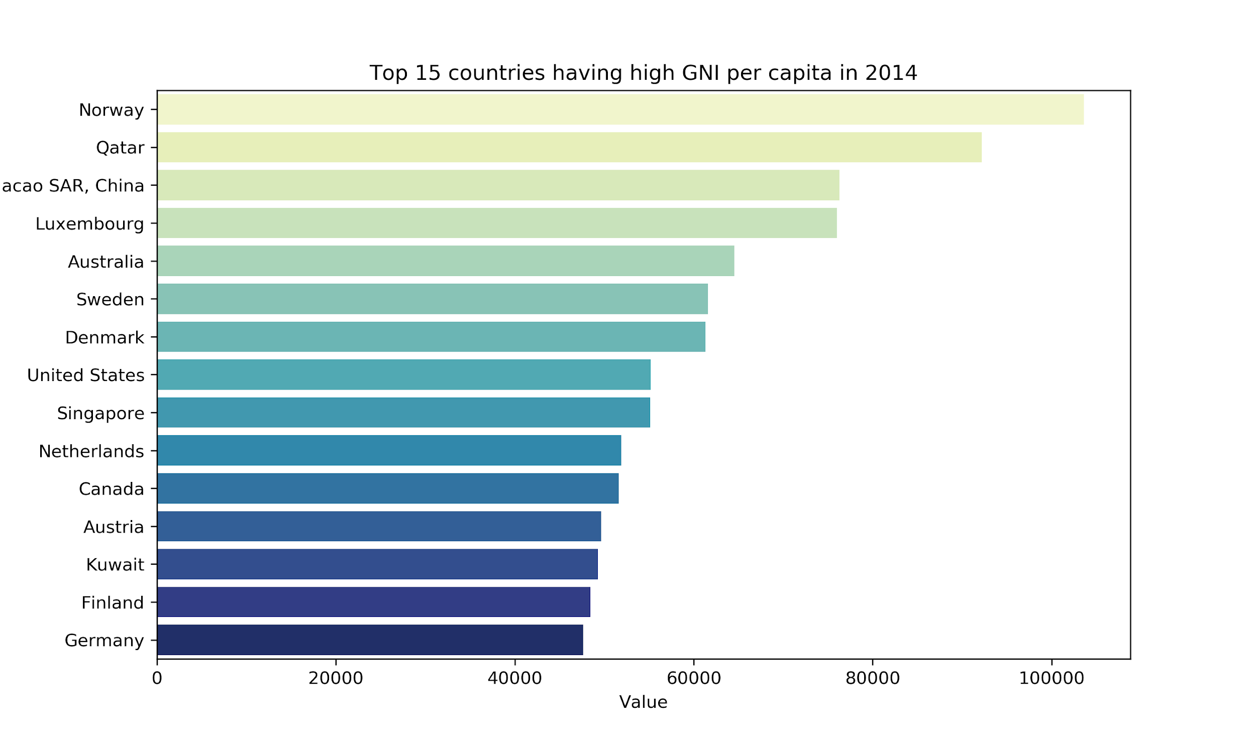
The first 15 countries which are having high GNI per capita in 1962 and 2014

Slide 6
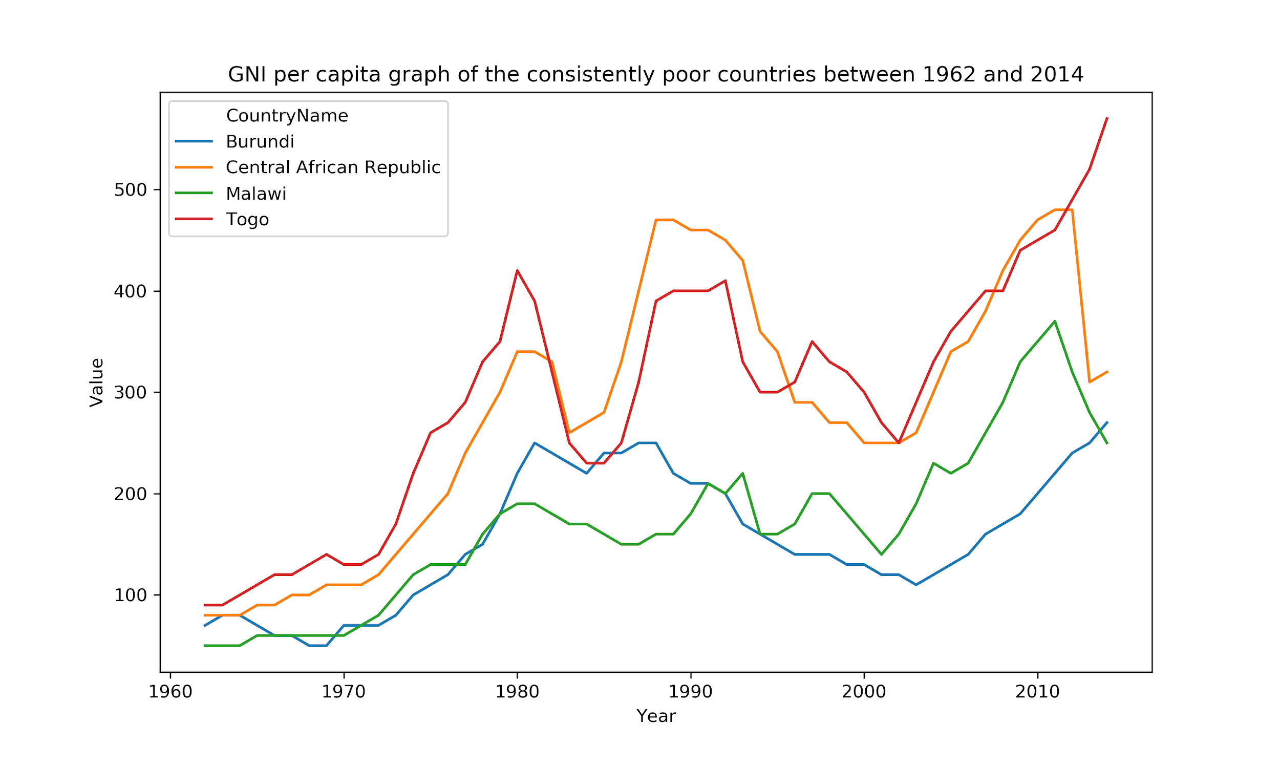
The consistently poor countries on the basis of GNI per capita from 1962 to 2014

Slide 7
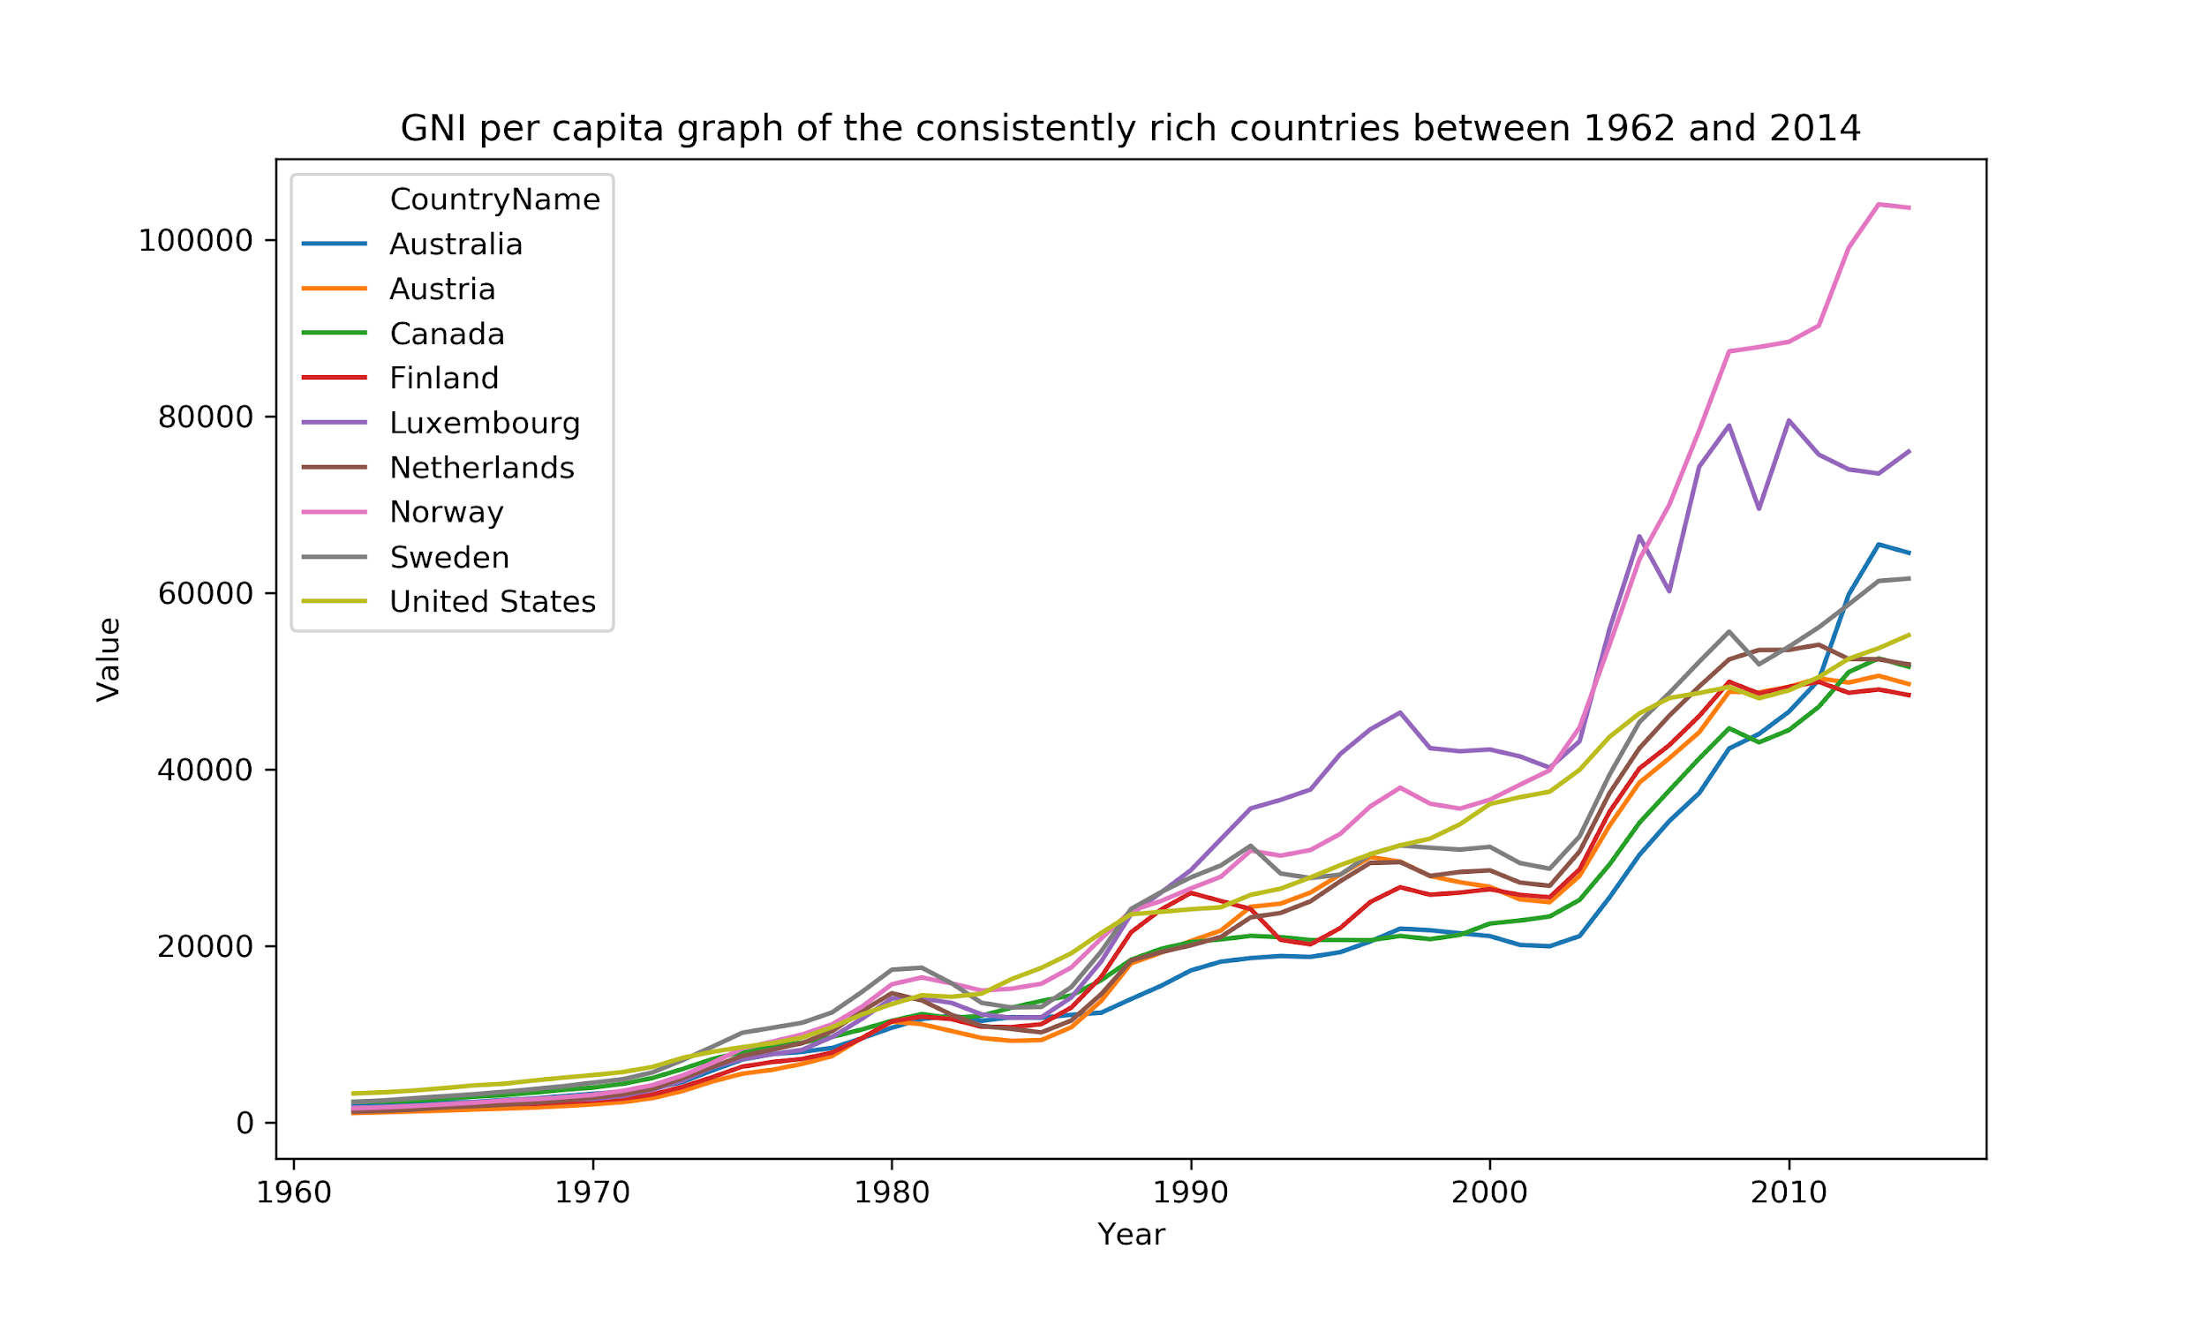
The consistently rich countries on the basis of GNI per capita from 1962 to 2014

Slide 8
INTERESTING FACT OF OUR ANALYSIS
It is interesting to note the geographic differences of low income countries in 1962 and 2014. In 1962, 5 of the 15 countries (China, India, Korea, Pakistan, Nepal) with lowest average income in the world were located in Asia. Switch to 2014 and it is interesting to note that every single one of the countries with lowest income in the world are all African with the exception of Afghanistan.

Slide 9
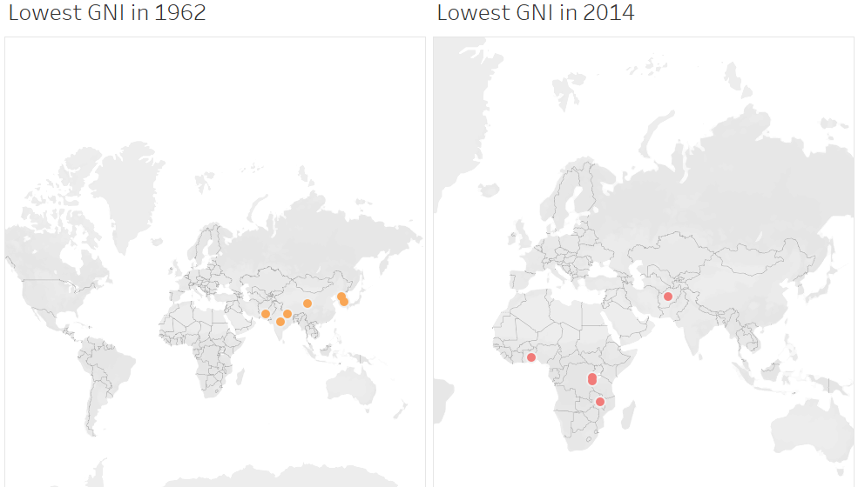
ANALYSIS ON TABLEAU

Slide 10
CONCLUSION ABOUT OUR TABLEAU ANALYSIS
It can be seen that 4 countries- Burundi, Central African Republic, Malawi, and Togo- have been in the poorest 15 in both the past (1960s) and the present.

Slide 11
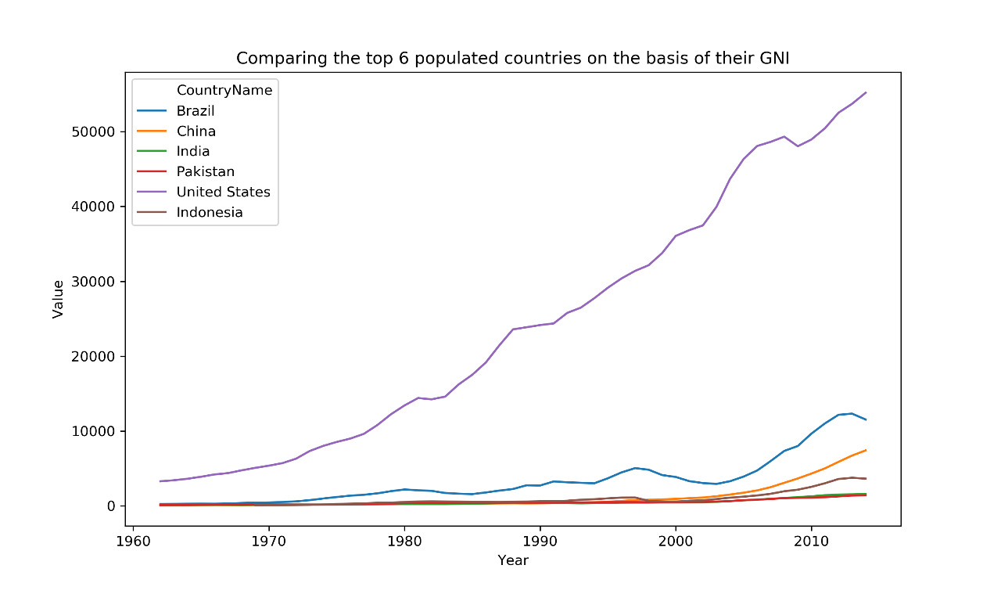
BONUS ADDITION ON OUR ANALYSIS
We have compared the top populated countries according to its PER CAPITA INCOME which is countries annual income divided by its total population.
China. 1,384,688,986.
India. 1,296,834,042.
United States. 329,256,465.
Indonesia. 262,787,403.
Brazil. 208,846,892.
Pakistan. 207,862,518.

Slide 12
CONCLUSION
According to our topic on EXPLORING GLOBAL INEQUALITY AND GROWTH we came to know about the GNI PER CAPITA OF COUNTRIES and how the major countries have grown on the basis of annual income .

Slide 13
THANK YOU.

